Slide 1
L2 Cloud Architecture
Prof. Dr. M. A. Rouf
Dept. of CSE, DUET, Gazipur

Slide 2
General Architecture of Cloud
Fig: Basic cloud service layout.

Slide 3
General Architecture of Cloud
Software as a Service (SaaS):
In this model, a complete application is delivered on demand to the cloud users.
Clients need not invest upfront before using the applications.
They use the software subscription based or followed the model Pay-as-you-go, such as Google, Salesforce and Microsoft

Slide 4
General Architecture of Cloud
Platform as a Service (PaaS):
In this model, the integrated development environment tools are provided to develop own business policy.
A predefined configuration of operation system and application server are delivered to cloud users. For an example, Force.com and Google's App Engine are providing as platform

Slide 5
General Architecture of Cloud
Infrastructure as a Service (IaaS):
The virtualization of resources are provided to run the application called the Infrastructure as a Service (IaaS).
The resources are virtual server, host, machine, storage, and computing capacity etc.
The cloud users deploy their own applications in cloud infrastructure such as Amazon and Go Grid

Slide 6
Basic Components of Cloud Computing
Cloudlets
Datacenter Broker
Cloud Information Services (CIS)
Datacenter

Slide 7
Basic Components of Cloud Computing
Cloudlets :
The cloudlet is an application which consists of million instructions (it is also known as a task such as social networking, content delivery and business application etc.).
Datacenter Broker:
The datacenter broker acts as a coordinator between software-as-as-services (SaaS) and cloud providers.
The main responsibility of broker collects the available resources and provides quality of service to clients of cloud system.

Slide 8
Basic Components of Cloud Computing
Datacenter :
A datacenter is a collection of virtualized hosts, virtual machines, processing elements, virtual networks and virtual storage.
A datacenter consists of X86 architecture, operating system, and virtual machine monitor (VMM), host list, memory, bandwidth and storage.
Cloud Information Services (CIS)
CIS sends the acknowledgement to the broker about available resources of cloud.

Slide 9
Basic Components of Cloud Computing
Host :
A host consists of multiple virtual machines.
The parameters of the host are:
Processing capacity: Usually measured in million instructions per second (MIPS)
Memory size: Megabyte (MB))
Storage size: Terabyte (TB)
Communication bandwidth: Megabyte per second (Mbps)
Virtual Machine (VM):
The VMs are allocated in a host with the best-fit mechanism.

Slide 10
Basic Components of Cloud Computing
Clients :
These are typically the computers, mobile phones and thin browser which are used by the end users.
Clients are cloud users that produces cloudlet for utilizing and deploying cloud components/services

Slide 11
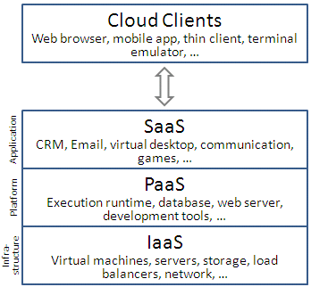
Infrastructure as a Service (IaaS)
IaaS:
A category of cloud services which provides capability to provision processing, storage, intra-cloud network connectivity services, and other fundamental computing resources of the cloud infrastructure. Source- [ITU –Cloud Focus Group]
IaaS
PaaS
SaaS
Virtual Machines
Virtual Networks
Auto Elastic
Continuous Integration
Built for Cloud
Uses PaaS

Slide 12
What is EC2 ?
Amazon Elastic Compute Cloud (EC2) is a web service that provides resizable computing capacity that one uses to build and host different software systems.
Designed to make web-scale computing easier for developers.
A user can create, launch, and terminate server instances as needed, paying by the hour for active servers, hence the term "elastic".
Provides scalable, pay as-you-go compute capacity
Elastic - scales in both direction

Slide 13
EC2 Concepts
AMI & Instance
Region & Zones
Storage
Networking and Security
Monitoring
Auto Scaling
Load Balancer

Slide 14
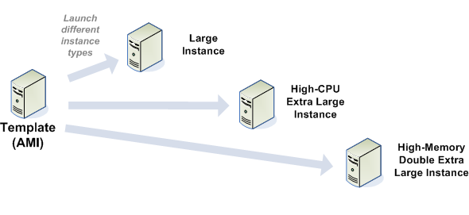
Amazon machine Images (AMI)
Is an immutable representation of a set of disks that contain an operating system, user applications and/or data.
From an AMI, one can launch multiple instances, which are running copies of the AMI.

Slide 15
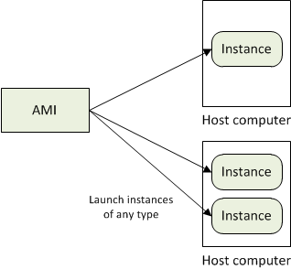
AMI and Instance
Amazon Machine Image (AMI) is a template for software configuration (Operating System, Application Server, and Applications)
Instance is a AMI running on virtual servers in the cloud
Each instance type offers different compute and memory facilities

Slide 16
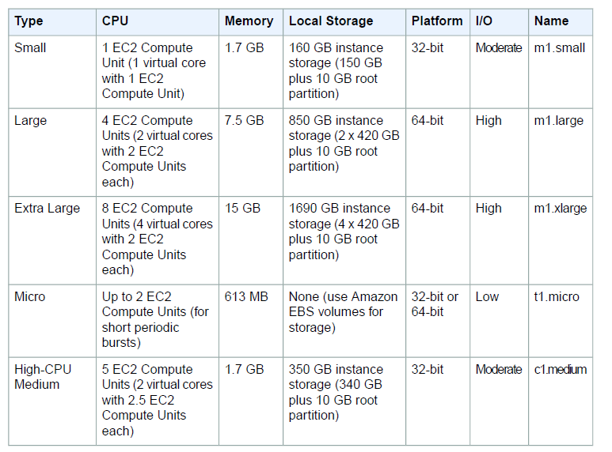

Slide 17
Region and Zones
Amazon have data centers in different region across the globe
An instance can be launched in different regions depending on the need.
Closer to specific customer
To meet legal or other requirements
Each region has set of zones
Zones are isolated from failure in other zones
Inexpensive, low latency connectivity between zones in same region
Notes:
for example, North America, Europe, and Asia).
Prices for Amazon EC2 usage vary by region
Each region contains multiple distinct locations called Availability Zones.

Slide 18
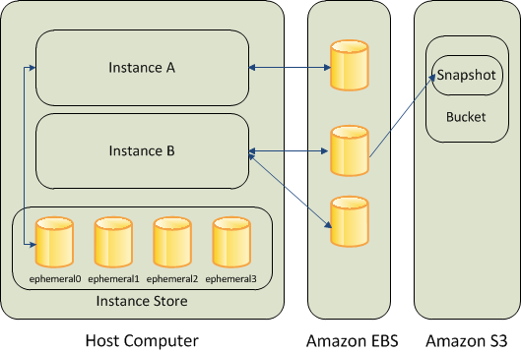
Storage
Amazon EC2 provides three type of storage option
Amazon EBS
Amazon S3
Instance Storage
Diagram Source: http://docs.aws.amazon.com
Notes:
Amazon EBS (Elastic Block Store) provides with persistent, block-level storage. Basically additional Hard Disk that you can attach to instance.
Suitable for apps which require database , filesystem , block level storage.
Create, Attach , Detach, Delete
- Standard volumes and Provisioned IOPS volumes.
Take snapshots that is stored in S3 , a new EBS can be re-created using the snapshot
Instance store comes with each instance except the micro-one , temporary block level storage.
Storage physically attached to the computer
S3 simple storage service
storage for the Internet
web service interface that enables you to store and retrieve any amount of data from anywhere on the web
Root device storage: contains image to boot the system
AMI categorized as “Backed by Amazon EBS” or “Backed by instance store”

Slide 19
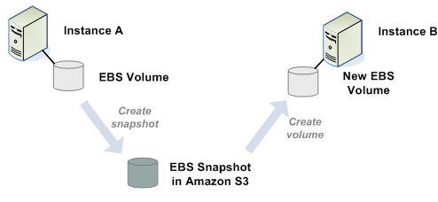
Elastic Block Store(EBS) volume
An EBS volume is a read/write disk that can be created by an AMI and mounted by an instance.
Volumes are suited for applications that require a database, a file system, or access to raw block-level storage.

Slide 20
Amazon S3
S3 = Simple storage Service
A SOA – Service Oriented Architecture which provides online storage using web services.
Allows read, write and delete permissions on objects.
Uses REST and SOAP protocols for messaging.

Slide 21
Amazon SimpleDB
Amazon SimpleDB is a highly available, flexible, and scalable non-relational data store that offloads the work of database administration.
Creates and manages multiple geographically distributed replicas of your data automatically to enable high availability and data durability.
The service charges you only for the resources actually consumed in storing your data and serving your requests.

Slide 22
Networking and Security
Instances can be launched on one of the two platforms
EC2-Classic
EC2-VPC
Each instance launched is assigned two addresses a private address and a public IP address.
A replacement instance has a different public IP address.
Instance IP address is dynamic.
new IP address is assigned every time instance is launched
Amazon EC2 offers Elastic IP addresses (static IP addresses) for dynamic cloud computing.
Remap the Elastic IP to new instance to mask failure
Separate pool for EC2-Classic and VPC
Security Groups to access control to instance
Notes:
VPC - launch Amazon Web Services (AWS) resources into a virtual network that you've defined.
Configure VPC: select its IP address range, create subnets, and configure route tables, network gateways, and security settings.
Security Group - enables you to specify the protocols, ports, and source IP ranges that are allowed to reach your instances
Create multiple security groups , assign instance to a particular group , determine the traffic

